Slide 1
Assignment – Linear Regression
Submitted By: Pooran Pragnya
November Batch (BDS)

Slide 2
1. Linear Regression:
It is based on supervised learning, it performs regression tasks
Linear Regression performs the task to predict a dependent variable (label) based on a given independent variable (feature) and it finds the linear relationship between them
Dependent variable is continuous in nature (that is it can be expressed in decimal form)
It is commonly used for predictive analysis
Example: 1. weight of a person is linearly related to height
2. Salary of person based on past experiences

Slide 3
2. Types of Linear Regression
1. Simple Linear Regression
2. Multiple Linear Regression

Slide 4
3. Simple Linear Regression
It is a type of linear regression where dependent variable (label) depends on only one independent variable (feature)
Example: 1. Salary of Person Depending only on Past Experiences.
2. Marks obtained by students based on number of hours

Slide 5
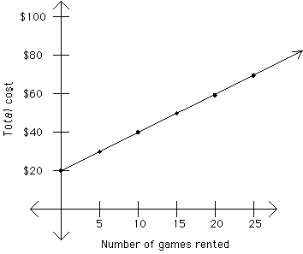
Representation of Simple Linear Regression

Slide 6
Equation for simple Linear Regression
Where,
Y = output/label/dependent Variable
m = Slope
X = independent Variable/Feature/Input
C= Intercept (the linear line where it cuts the y-axis)
Y = mX+C

Slide 7
4. Multiple Linear Regression
It is a type of linear regression where dependent variable (Label) depends on more than one independent variables or features.
Example: House Price Prediction, Salary Hike in a company etc.
Square Feet | Total No. of Rooms | No. of Bed Rooms | Price (in Lakh Rupees)
1250 | 04 | 01 | 25.00
1500 | 05 | 02 | 30.00
1800 | 06 | 02 | 40.00
2500 | 08 | 03 | 60.00

Slide 8
Equation for Multiple Regression
Where,
Y = Dependent Variable (Label)
C = Interceptor
M1, M2….Mn Are Slopes of Independent Variables
X1, X2…. Xn Are Independent Variables
Y = C+M1X1+M2X2+M3X3+……MnXn

Slide 9
M1, M2 …Mn are slopes of independent variables.
Depending on the value of slope, we can find which independent variable/feature impacts the dependent variable/output/label more than others and we can prioritize which independent factor/variable is utmost important and next and so on.

